Slide 1

Impact of Fortune 500 Companies on Local Economies

Slide 2

Presenters: Eric Ruzzo Carlos Roa Yissel Fernandez Rodrigo Anglarill

Slide 3


Where did we get our Data From?

Slide 4

What are we looking for?
We were interested in analyzing how the location of a Fortune 500 Headquarter can impact the following:
unemployment rates
Poverty
Household incomes
Average rent
Wages

Slide 5

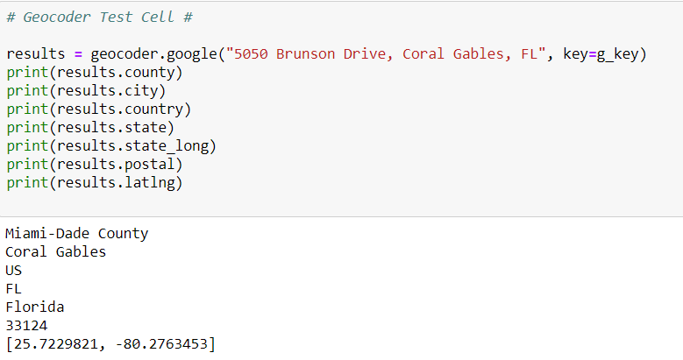
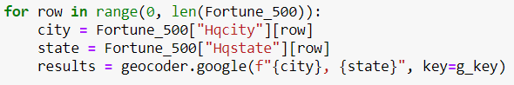
Geocoder is a python module that utilizes various APIs, including Google, for geolocation
Saves a lot of time AND a lot of code
Utilized in our project to find the county that each Fortune 500 hq is located
However, it did cause issues when the result it displayed differed from the way it was displayed in our other dataframes

Slide 6
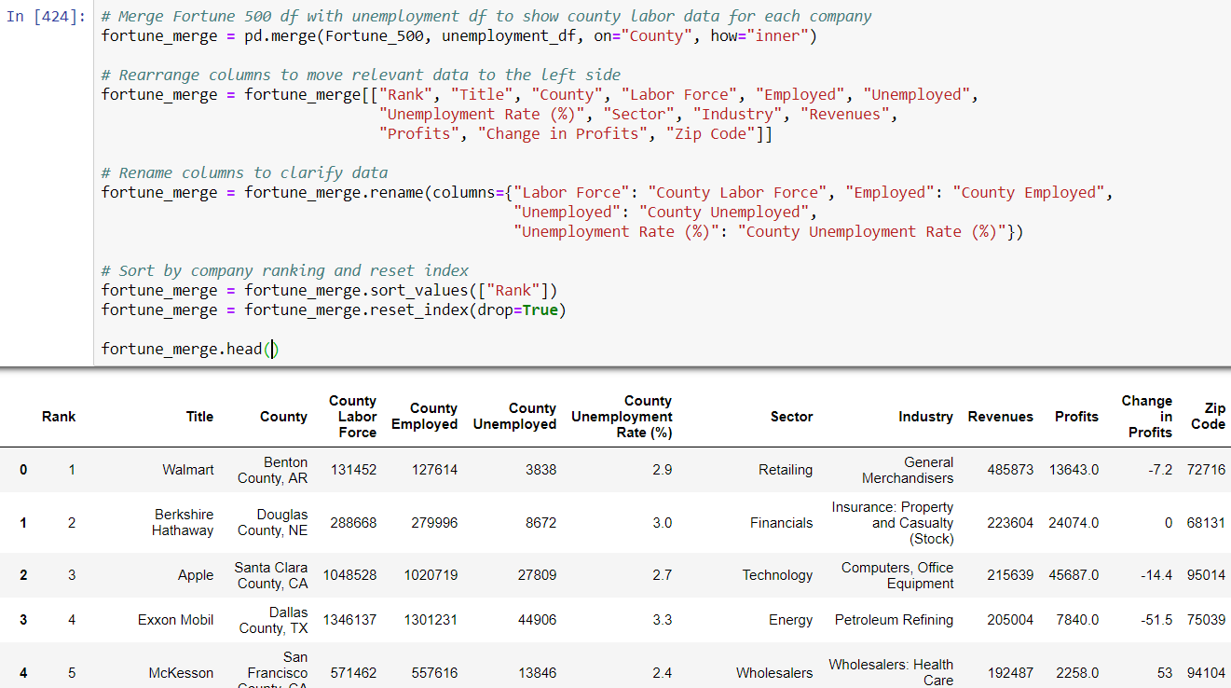

Slide 7
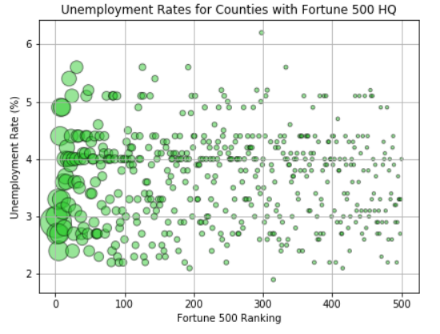
Relationship to Unemployment
There is no clear relationship between the unemployment rate and the presence of a Fortune 500 company headquarters
The size of each point is total revenue in 2017. The plot shows a fairly even distribution regardless of revenue and Fortune 500 ranking.
No relationship between revenue and county unemployment rates
There is a strong band at 4.0% unemployment due to 46 company headquarters located in New York City.

Slide 8
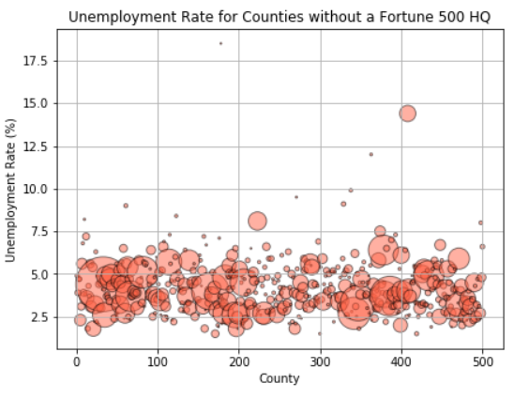
Non-Fortune 500 Unemployment
Again, there is no clear relationship between unemployment and the lack of Fortune 500 headquarters
Counties chosen from random selection of 500 counties without a Fortune 500 headquarters
Unemployment rates mostly fall in the same range as the Fortune 500 counties, but there is a greater occurrence of rates of 6%.
Since there is no revenue, marker size is based on total labor force. The highest unemployment rate comes from a very small labor force, but the next highest is larger.
No relationship between labor force size and unemployment rate, as there are many small labor forces in the lower part of the plot.

Slide 9

Poverty and HH Income

Slide 10
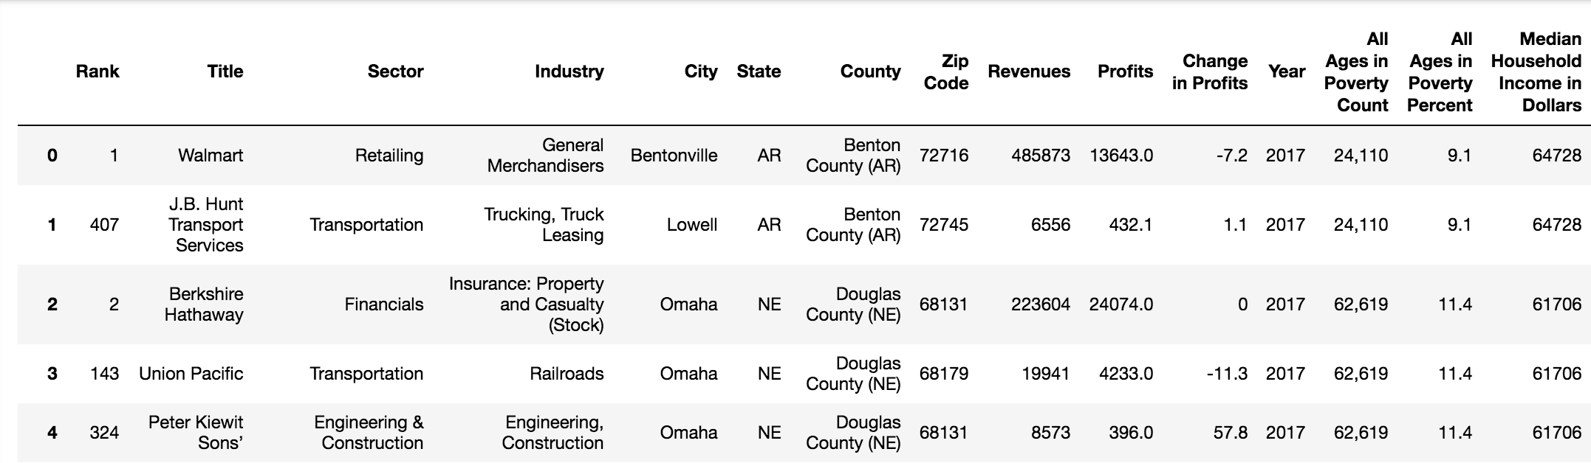
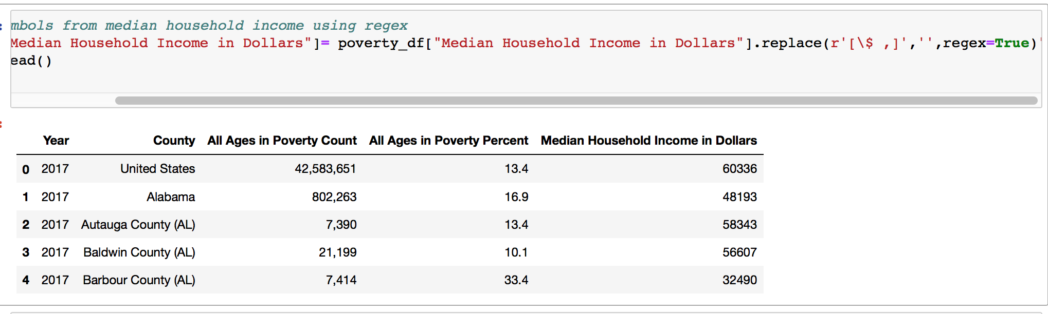

Slide 11
Relationship to HH Income
There seems to be no discernable relationship between rank and Median House Hold income

Slide 12
Sector and HH Income

Slide 13
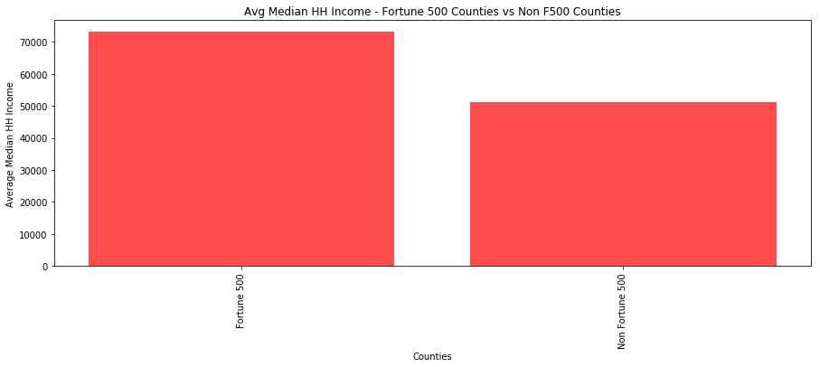
The average HH income for F500 zips is 73,110.79 otherwise its 51,134.194

Slide 14
Relationship Between Revenues and Poverty
No Discernable Relationship between Revenues and People in Poverty

Slide 15
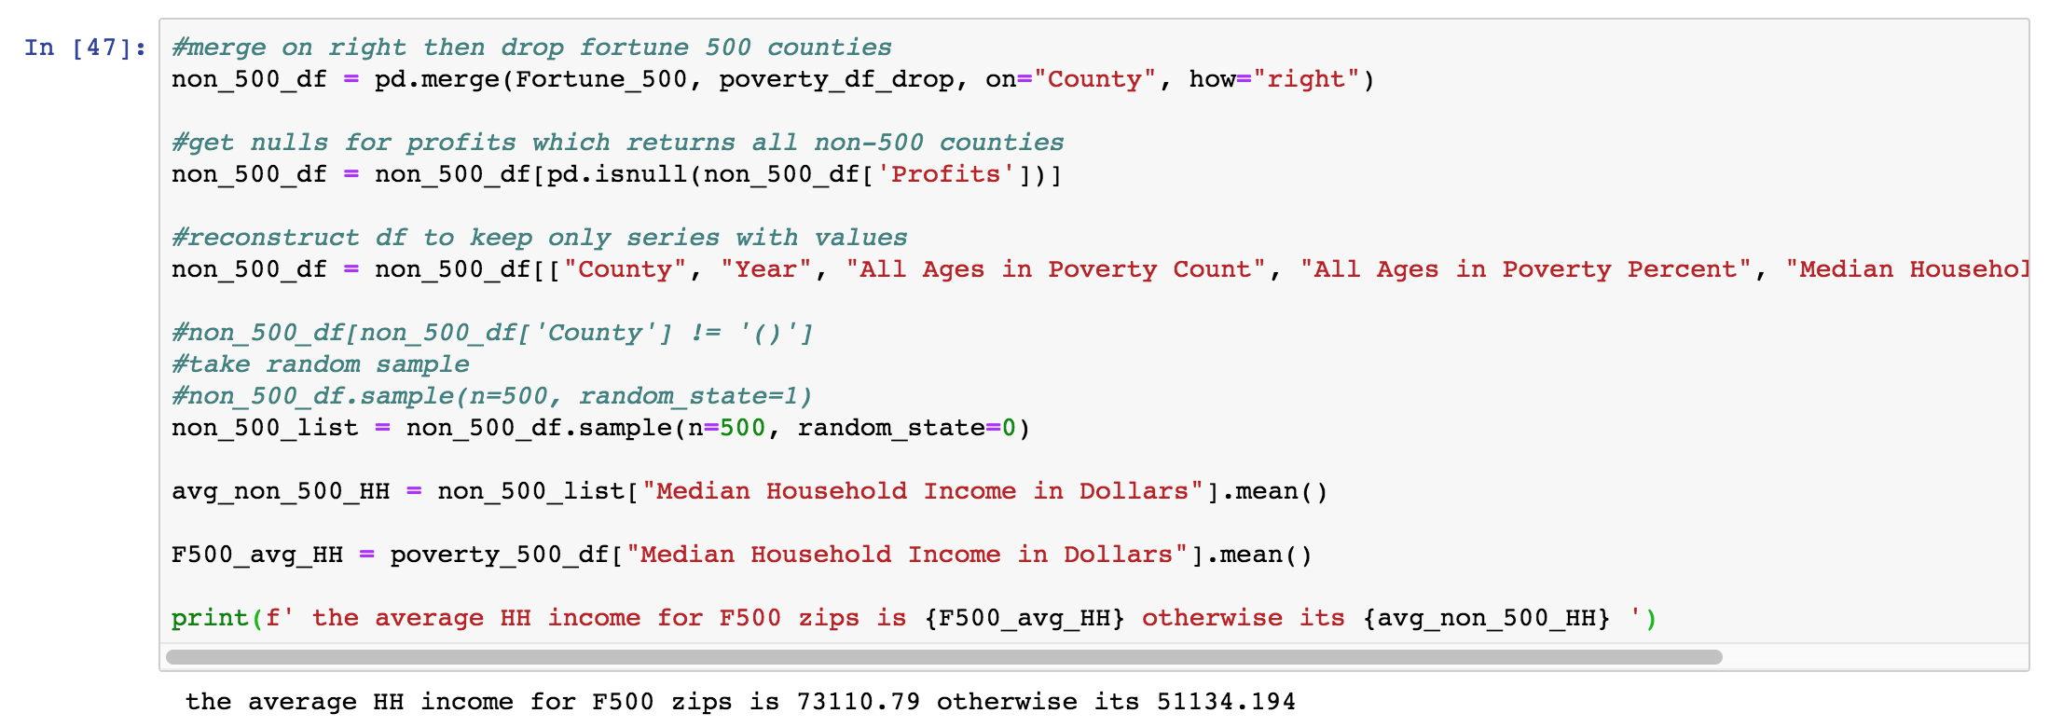

Slide 16
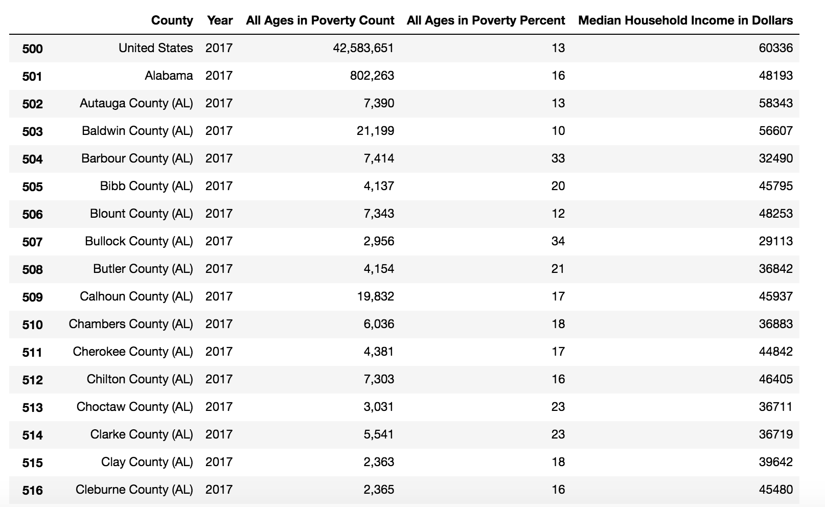

Slide 17

Average Rental Rate in cities with a Fortune 500 Headquarter

Slide 18
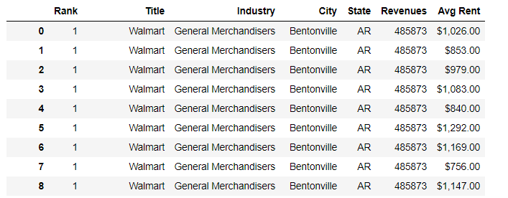
Average rent per City

Slide 19

Fortune 500 vs Wages By County

Slide 20
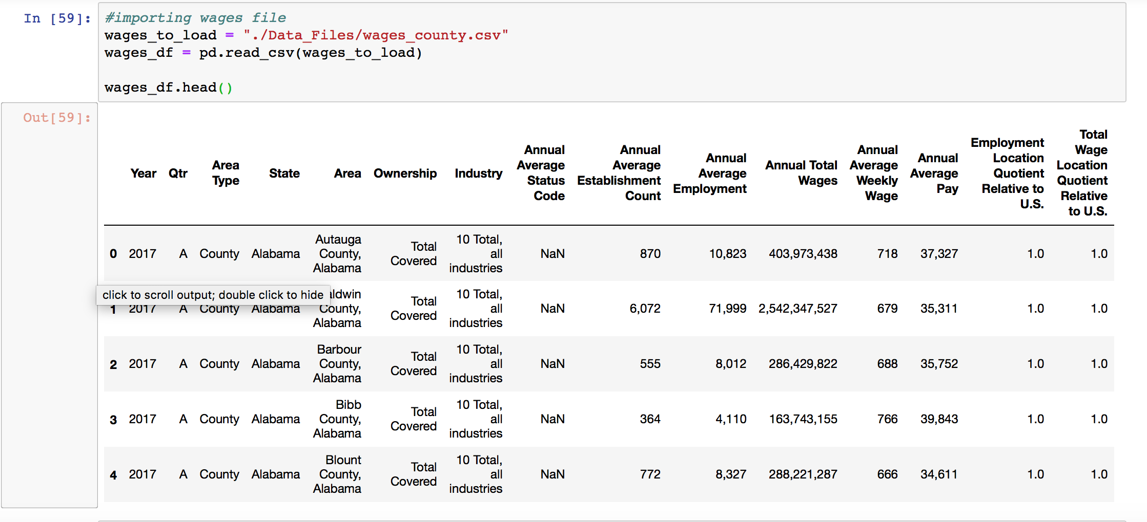

Slide 21
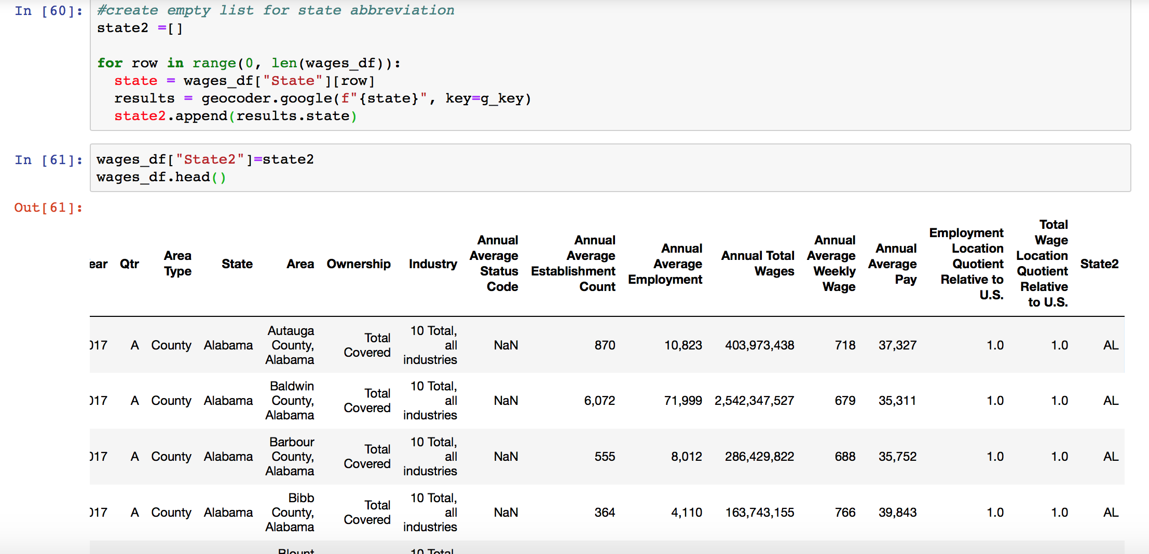

Slide 22
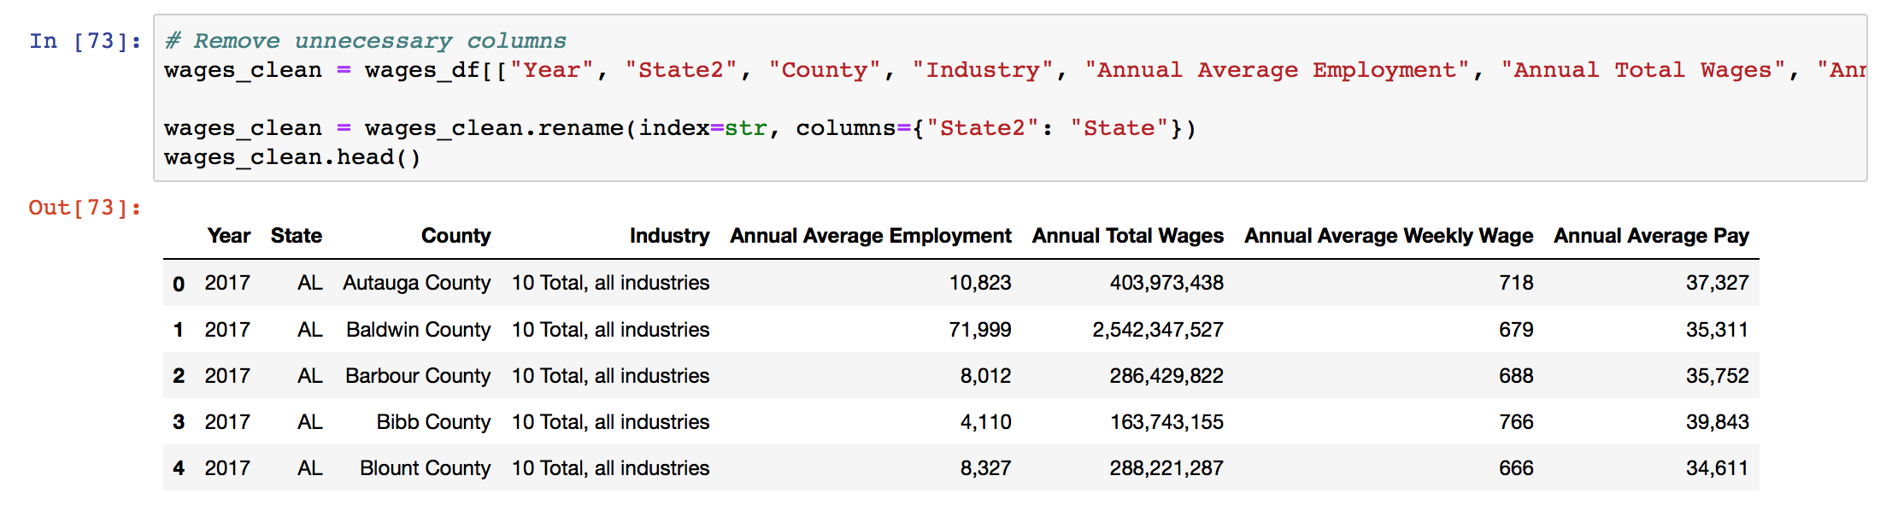

Slide 23
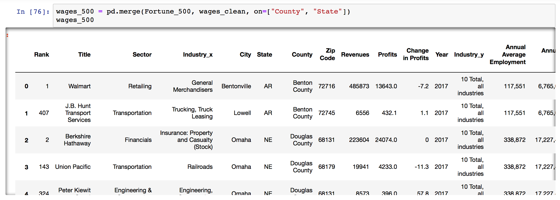

Slide 24
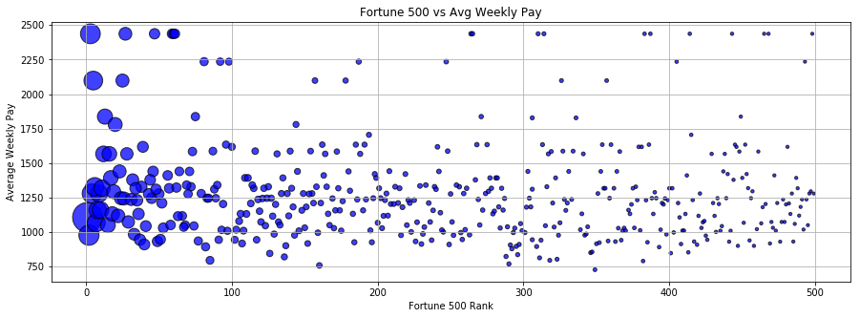
There is no real relationship. Fortune 500 companies have an average weekly pay in between 1,000 and 1,500.Santa Clara County, which is Silicon Valley area, it is the county with the highest weekly pay

Slide 25
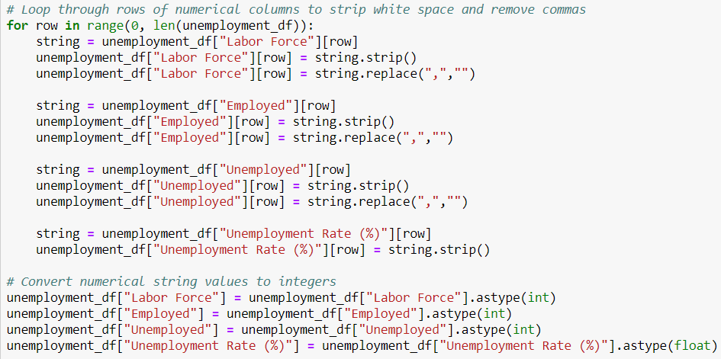
Coding Issues
Many coding issues came about as a result of the csv data not matching the Geocoder results.
When read in, the csv also displayed numerical data as strings with extra white space at the end.
Multiple loops had to be run to correct these issues
Code shows process used to remove white space and cast strings to integers and floats.

Slide 26

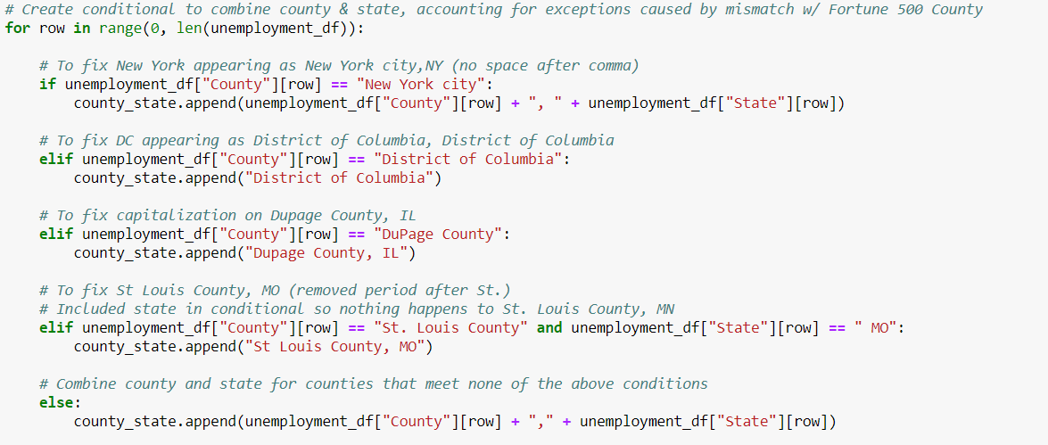
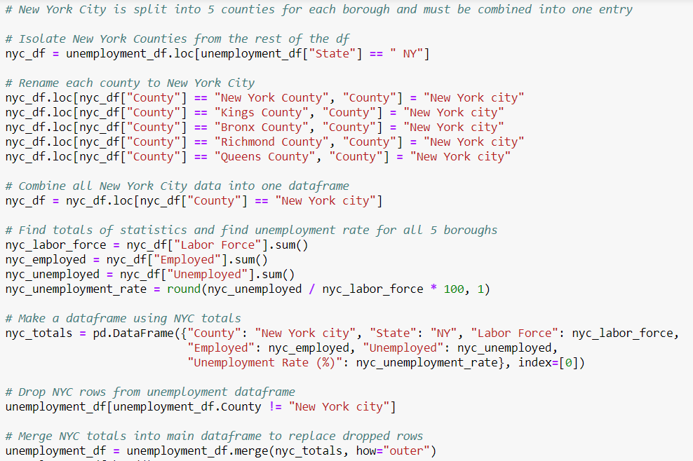
Additional Issues
To fix individual counties when combining with state
To combine all 5 boroughs in NYC and their totals into one entry

Slide 27
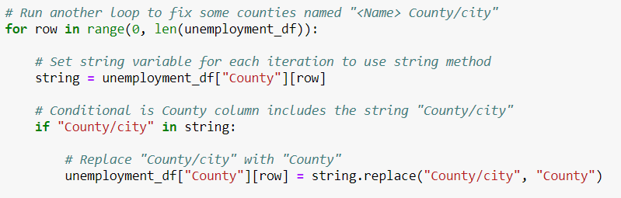
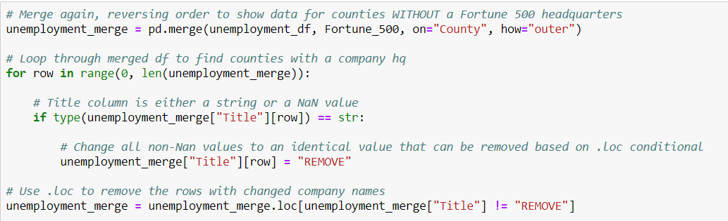
Even More Issues
To change rows including “County/city” to just “county”
Had to merge and then remove fortune 500 counties to isolate only counties without a headquarters

Slide 28
Complications
If we had more time, we would’ve liked to explore data over time – How the relocation of a headquarter can affects certain local economy/ Company Ranking Changes/ etc.
We would’ve liked to run a regression analysis in order to explore relationships in depth
Explore economies at a more “localized” level. We feel as though relationships would be more present at the zip code level, however we were unable to find the data that way. County seems to be too broad.
We would have like to create more plots with more varied plot types

Slide 29


